Slide 1
Convolutional Neural Networks (CNNs)
How Cat Videos Helped Kick-Start AI
Presenter: Edward Preble
Other Investigators: Ian Thomas, Kasey Jones, Rob Chew
DOG
CAT

Slide 2
Sooooo complicated…. do I REALLY need to care???
YES

Slide 3
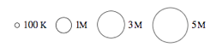
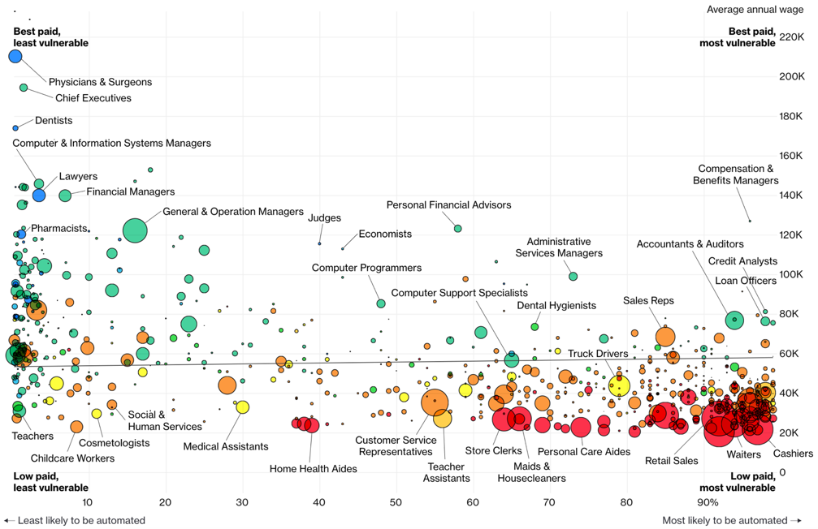
Jobs likely to be displaced by automation (esp. Neural Networks)
Bloomberg 7/2017

Slide 4
Lecture Agenda
What is a Convolutional Neural Network (CNN)?
Tensorflow Playground CNN Demo
History of CNN advances
Application of CNNs in Image Analysis
Object Classification (Tensorflow for Poets, flower demo)
Object Detection (Tensorbox, locating mosquito breeding grounds)
Real time object detection (YOLO TED Talk)
Training data headaches
Using video to capture training data more easily
Cautionary notes
Intro
CNN Details
Applications
Training
Caution
Wrap Up

Slide 5
Lecture Agenda
What is a Convolutional Neural Network (CNN)?
Tensorflow Playground CNN Demo
History of CNN advances
Application of CNNs in Image Analysis
Object Classification (Tensorflow for Poets, flower demo)
Object Detection (Tensorbox, locating mosquito breeding grounds)
Real time object detection (YOLO TED talk)
Training data headaches
Using video to capture training data more easily
Cautionary Notes
Intro
CNN Details
Applications
Training
Caution
Wrap Up

Slide 6
What is a CNN?
Neural Network
Makes predictions by learning the relationship between your data and some response
Convolutional Neural Network
Convolution layers act as “detectors” for certain features
Intro
CNN Details
Applications
Training
Caution
Wrap Up

Slide 7
CNN Diagram for Image Analysis
All Image Pixels
Edges/Curves
Eyes/Nose
Dog
Input Data
Input Layers
Detection Filters
Simple Features
Detection Filters
Complex Features
Classification
Inception v3
(Google CNN Architecture)
Intro
CNN Details
Applications
Training
Caution
Wrap Up

Slide 8
How are CNN’s going to automate jobs?
CNN’s are enabling a big leap for sensory data processing (auditory, visual, IoT sensors)
Image Recognition Accuracy
Intro
CNN Details
Applications
Training
Caution
Wrap Up

Slide 9
Neural network perfect storm has arrived
Viable NN Products Need:
Availability of Training Data
Complex Models (deep networks)
Hardware (GPUs)
ImageNet Competition Winning Model
Intro
CNN Details
Applications
Training
Caution
Wrap Up
Notes:
Data wise, to train a CNN to identify a complex object, one needs ~10,000 diverse examples of the object
A computer can’t tell a dog and a cat apart with just a few variables
If you have a ton of data, and a very complex model, you need fast computing. Introduction of GPU usage for these calculations was key.

Slide 10
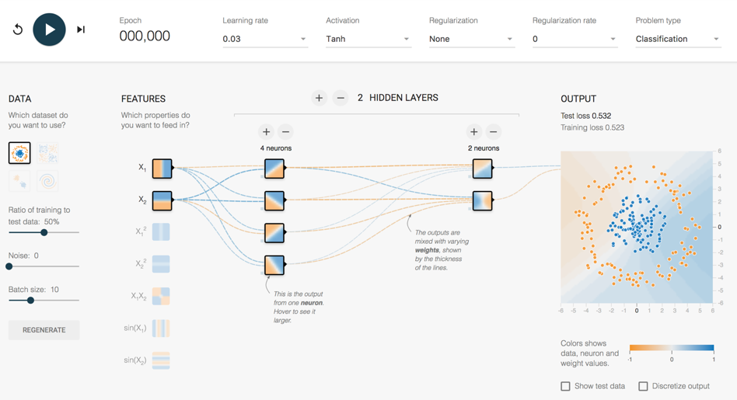
How does it work?
http://playground.tensorflow.org/
Intro
CNN Details
Applications
Training
Caution
Wrap Up

Slide 11
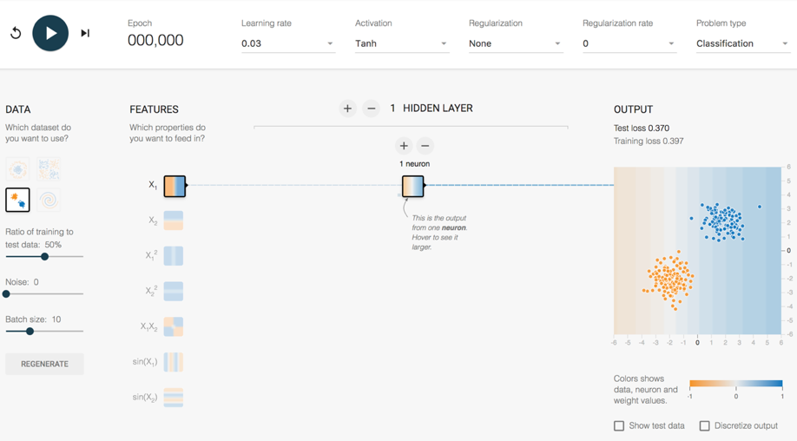
Playground Demo 1
2 Clumps 1 Feature 1 Hidden Layer
1 Neuron
Intro
CNN Details
Applications
Training
Caution
Wrap Up
Notes:
Explain tanh function (similar to logit 0-1, except -1-1)
Dividing line, left is orange, right is blue. Probability of being orange/blue is higher as you go farther from the divide.
Look at random initial weights
Single click advance the model on the vertical feature only
Watch weights increase
Division gets clearer
Test loss gets lower and lower
Reset – show learning rate effect
Activation Function – Tanh, ReLU
Single click advance the model on the horizontal feature only
Single click advance the model on the vertical + horizontal
Show next 3 features that they don’t work
Do all 5 together
Weights that increase are said to be ACTIVATED

Slide 12
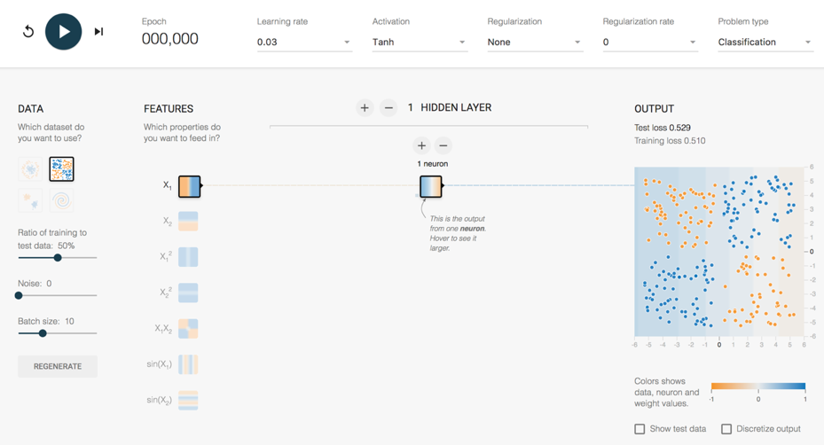
Playground Demo 2
4 Clumps 1 Feature 1 Hidden Layer
1 Neuron
Intro
CNN Details
Applications
Training
Caution
Wrap Up
Notes:
1 feature, 1 layer, 1 neuron – terrible
2 feature, 1 layer, 1 neuron – now get an angle, better
Lets add a second layer
2 feature, 2 layer, 1/1 neuron – Makes no sense to have single neuron into single neuron, can reverse info, but can’t adjust it
Add second neuron to layer 1
2 feature, 2 layer, 2/1 neuron – Sometimes single line, like above. Sometimes more of a “corner”, sometimes makes a valley (best)
Hover over neurons and weights for each neuron to show how it adds up
What is the best way to make this work? Use the feature that fits the data better
1 x1x2 feature, 1 layer, 1 neuron
With small networks of the past, feature engineering was where everyone worked to make this stuff happen. Good features = Good model. Bad features = no luck.
But, what is the magic feature to tell a cat apart from a dog?

Slide 13
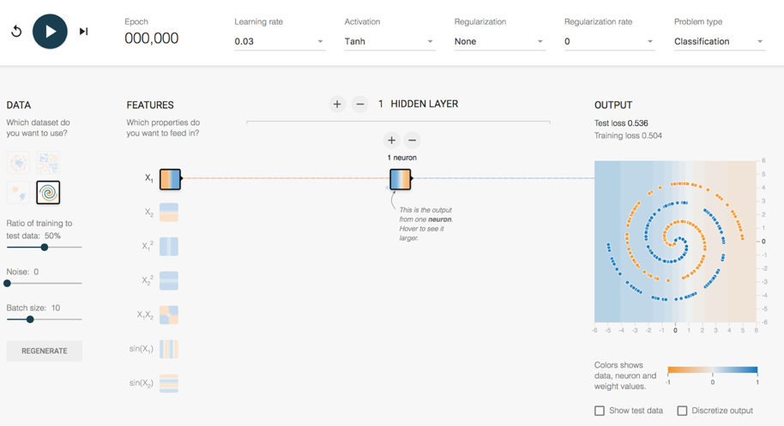
Playground Demo 3
Spiral 1 Feature 1 Hidden Layer
1 Neuron
Intro
CNN Details
Applications
Training
Caution
Wrap Up
Notes:
More complex Shape – Spiral
1 feature, 1 layer, 1 neuron – terrible
All features, - starts making dots
All features , 1 layer, 2 neurons
All features – Keep trying until a semblance of a spiral
All features , 2 layers, 2 neurons, spirals lots of other stuff
All features , 5 layers, top layers are washed out. No new information being generated.
All features , 5 layers, 5/4/3/2/1, might get it
6 layers, 7/6/5/4/3/2, starts working pretty well pretty quickly – weird looking, but works

Slide 14
How does a CNN “Learn”?
Backpropagation
Initial network settings are random
Test prediction using training data
Adjust network by a certain amount (Learning Rate) to reduce the error
Start at the end of the network and work backwards
?
Dog
Dog
Dog
?
Cat
Cat
Cat
?
?
Intro
CNN Details
Applications
Training
Caution
Wrap Up

Slide 15
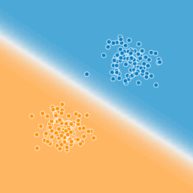

Is that it?
Blue
Cat
Cat
Typing
on
Laptop
Cat
Typing
on
Laptop
in the
Kitchen
How to get to here?
Orange
Intro
CNN Details
Applications
Training
Caution
Wrap Up

Slide 16
How complex are these models?
All Image Pixels
Edges/Curves
Eyes/Nose
Dog
Input Data
Input Layers
Detection Filter
Simple Features
Detection Filter
Complex Features
Classification
Inception v3
(Google CNN Architecture)
Number of Parameters = 23,200,000
Number of Layers = 48
Intro
CNN Details
Applications
Training
Caution
Wrap Up
Notes:
Back to the structure of the CNN, and how these layers start really working for complex images.
For an image, the input layers, instead of being data points like the playground example, they will be the actual pixel values for the image. The last model I used at RTI had 704x704 pixel input images, with 3 colors (RGB), which translates into ~1.5M input neurons.
So, you feed this image into the network, certain neurons and features will “activate”, which will then output at the end, is it blue or orange? Is it a cat or a dog?
On Inception v3, the number of layers is 48, the number of parameters is ~23M, the number of multiply/add calculations per sweep is ~5B.
This is DEEP LEARNING. There is a ton going on under the hood.

Slide 17
Lecture Agenda
What is a Convolutional Neural Network (CNN)?
Tensorflow Playground CNN Demo
History of CNN advances
Application of CNNs in Image Analysis
Object Classification (Tensorflow for Poets, flower demo)
Object Detection (Tensorbox, locating mosquito breeding grounds)
Real time object detection (YOLO TED talk)
Training data headaches
Using video to capture training data more easily
Cautionary Notes
Intro
CNN Details
Applications
Training
Caution
Wrap Up

Slide 18
History of CNN Advances (Early)
1943 – Model an algorithm on human neurons
1970s/80s
Computers gaining broad acceptance, but computational speed still too slow
1990 - Yann Lecun (Bell Labs, now at Facebook)
Number recognition using LeNet (first CNN application)
Big Data? 60,000 hand written post office zip code samples
2006 - Geoff Hinton (Univ. of Toronto, now at Google)
Stacked several shallow networks together → First “Deep Network” (4-8 layers)
2009 - Geoff Hinton
Trained voice recognition network in <3 weeks
Matched decades-to-build state of the art
Intro
CNN Details
Applications
Training
Caution
Wrap Up
Notes:
https://www.youtube.com/watch?v=n6XSDA3kfEw
http://slazebni.cs.illinois.edu/spring17/lec01_cnn_architectures.pdf

Slide 19
History of CNN Advances (Recent)
2011 -
For image recognition, typical networks were shallow (~4 layers)
2012 – Geoff Hinton (again)
AlexNet, 8 layers
Major image analysis breakthrough
Huge leap for CNNs. Python based. GPU trained.
2014
22 layers – Inception v1 (GoogLeNet)
2015
48 Layers – Inception v3
152 Layers – ResNet
2017
Tensorflow libraries open-sourced by Google
Intro
CNN Details
Applications
Training
Caution
Wrap Up

Slide 20
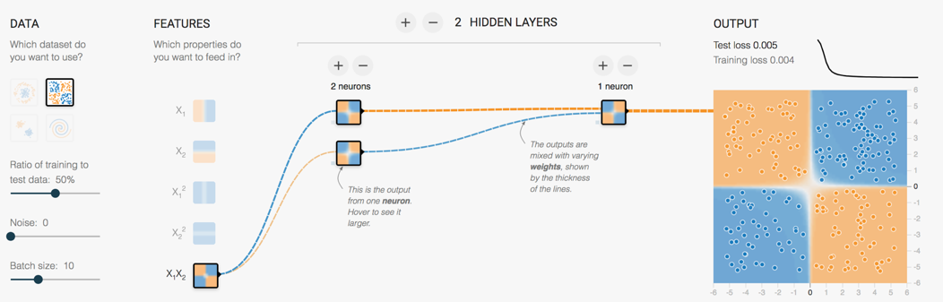
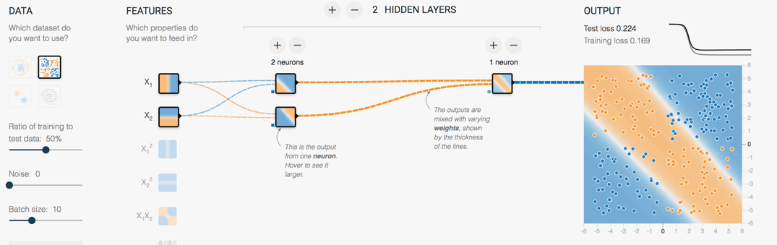
Another key advance
Retraining the last layer is all that is needed for basic human recognizable objects
ImageNet trained weights for Inception v3 are downloadable
Intro
CNN Details
Applications
Training
Caution
Wrap Up
Notes:
Remember beginning of lecture, to make the 4 blob data work, we could battle with linear features and a few layer/neuron combos
Or, just needed to use the right feature and it works instantly
Google (and others) have figured out those features and pre-trained a number of model architectures

Slide 21
Where are we today
Computational platform → Tensorflow
Model architecture → Inception_v3 structure
ImageNet pre-trained weights
Python scripts to handle the retraining
Intro
CNN Details
Applications
Training
Caution
Wrap Up

Slide 22
Discussion Topics
What is a Convolutional Neural Network (CNN)?
Tensorflow Playground CNN Demo
History of CNN advances
Application of CNNs in Image Analysis
Object Classification (Tensorflow for Poets, flower demo)
Object Detection (Tensorbox, locating mosquito breeding grounds)
Real time object detection (YOLO TED talk)
Training data headaches
Using video to capture training data more easily
Cautionary Notes
Intro
CNN Details
Applications
Training
Caution
Wrap Up

Slide 23
Applications of CNNs in Image Analysis
Classification
& Localization
Instance
Segmentation
Classification
Object Detection
Intro
CNN Details
Applications
Training
Caution
Wrap Up

Slide 24
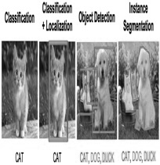

Applications of CNNs in Image Analysis
Classification
& Localization
Instance
Segmentation
Classification
Object Detection
Intro
CNN Details
Applications
Training
Caution
Wrap Up

Slide 25
Object Classification
Original Demo from Google: https://codelabs.developers.google.com/codelabs/tensorflow-for-poets
Jupyter Notebook Demo: http://localhost:8888/notebooks/Image_Classification_Tensorflow_for_Poets.ipynb
My notebooks available for download at GitHub git clone https://github.com/epreble/ncsu_iaa_cnn_guest_lecture.git
Intro
CNN Details
Applications
Training
Caution
Wrap Up

Slide 26
Lecture Agenda
What is a Convolutional Neural Network (CNN)?
Tensorflow Playground CNN Demo
History of CNN advances
Application of CNNs in Image Analysis
Object Classification (Tensorflow for Poets, flower demo)
Object Detection (Tensorbox, locating mosquito breeding grounds)
Real time object detection (YOLO TED talk)
Training data headaches
Using video to capture training data more easily
Cautionary Notes
Intro
CNN Details
Applications
Training
Caution
Wrap Up

Slide 27
Existing Applications of Object Detection
Autonomous driving – All driving context objects
Manufacturing – Anomaly detection for quality control
Face recognition – Customer or friend identification
People counting – Store visitor or crowd counting
Online image censoring – Nudity, violence, contraband detection
Security – Automated detection of weapons, intruders
Intro
CNN Details
Applications
Training
Caution
Wrap Up

Slide 28
Object Detection – RTI Use Case
Mosquito breeding site identification in Guatemala
Current Solution
Walking teams
Desired Solution
Target map assists walking team
Intro
CNN Details
Applications
Training
Caution
Wrap Up

Slide 29
Lecture Agenda
What is a Convolutional Neural Network (CNN)?
Tensorflow Playground CNN Demo
History of CNN advances
Application of CNNs in Image Analysis
Object Classification (Tensorflow for Poets, flower demo)
Object Detection (Tensorbox, locating mosquito breeding grounds)
Real time object detection (YOLO TED talk)
Training data headaches
Using video to capture training data more easily
Cautionary Notes
Intro
CNN Details
Applications
Training
Caution
Wrap Up

Slide 30
How a computer learns to recognize objects instantly | Joseph Redmon
YOLO TED talk https://www.youtube.com/watch?v=Cgxsv1riJhI&t=1s
Intro
CNN Details
Applications
Training
Caution
Wrap Up

Slide 31
Lecture Agenda
What is a Convolutional Neural Network (CNN)?
Tensorflow Playground CNN Demo
History of CNN advances
Application of CNNs in Image Analysis
Object Classification (Tensorflow for Poets, flower demo)
Object Detection (Tensorbox, locating mosquito breeding grounds)
Real time object detection (YOLO TED talk)
Training data headaches
Using video to capture training data more easily
Cautionary Notes
Intro
CNN Details
Applications
Training
Caution
Wrap Up

Slide 32
Organizing Image Training Data
Can be VERY time consuming.
Data science 80/20 rule
Object Detection Requires:
Images
Object class bounding boxes
Different input file types
Image1, Cat, 100, 0, 200, 200
Intro
CNN Details
Applications
Training
Caution
Wrap Up

Slide 33
Real world images can be very busy
Intro
CNN Details
Applications
Training
Caution
Wrap Up

Slide 34
New idea!
Use Video & Object Tracking to generate lots of training images Demo Object_Tracker_for_Video.py
Intro
CNN Details
Applications
Training
Caution
Wrap Up

Slide 35
Lecture Agenda
What is a Convolutional Neural Network (CNN)?
Tensorflow Playground CNN Demo
History of CNN advances
Application of CNNs in Image Analysis
Object Classification (Tensorflow for Poets, flower demo)
Object Detection (Tensorbox, locating mosquito breeding grounds)
Real time object detection (YOLO TED talk)
Training data headaches
Using video to capture training data more easily
Cautionary Notes
Intro
CNN Details
Applications
Training
Caution
Wrap Up

Slide 36
Gartner Hype Cycle for 2017
Intro
CNN Details
Applications
Training
Caution
Wrap Up

Slide 37
Model Bias
What if a flower classification model is better at roses than tulips?
What if a facial recognition model is better at Caucasian than African American faces?
How might that impact real people, not just marketing or profit margins?
Don’t ignore the ethics of how a model might be applied. Make those discussions happen.
Demonstrated leadership on ethical bias issues can benefit a company by building their brand and customer loyalty
Intro
CNN Details
Applications
Training
Caution
Wrap Up

Slide 38
Resources to Learn More
Entry Level Videos:
Josh Gordon (Google) Machine Learning Tutorials https://www.youtube.com/watch?v=cKxRvEZd3Mw
Siraj Raval - Various Artificial Intelligence Videos https://www.youtube.com/channel/UCWN3xxRkmTPmbKwht9FuE5A
More Advanced
Adrian Rosebrock (Lots of Python and OpenCV Materials) https://www.pyimagesearch.com/
Geoffrey Hinton’s Coursera Class https://www.coursera.org/learn/neural-networks
Intro
CNN Details
Applications
Training
Caution
Wrap Up

Slide 39
Thanks!
Break Time!
Optional demo next
Demo goals:
Train an Inception v3 model to recognize 3 students
Use video to get 200+ training images quickly
Train the model and test it!
Intro
CNN Details
Applications
Training
Caution
Wrap Up

